Slide 1

Smart Security System Using Motion Sensor and ESP32

Slide 2
















TANYA VERMA
SURYANSH KHARE
OUR
TEAM
CHANCHATI VARSHA
NENAVATH ANIL KUMAR

Slide 3
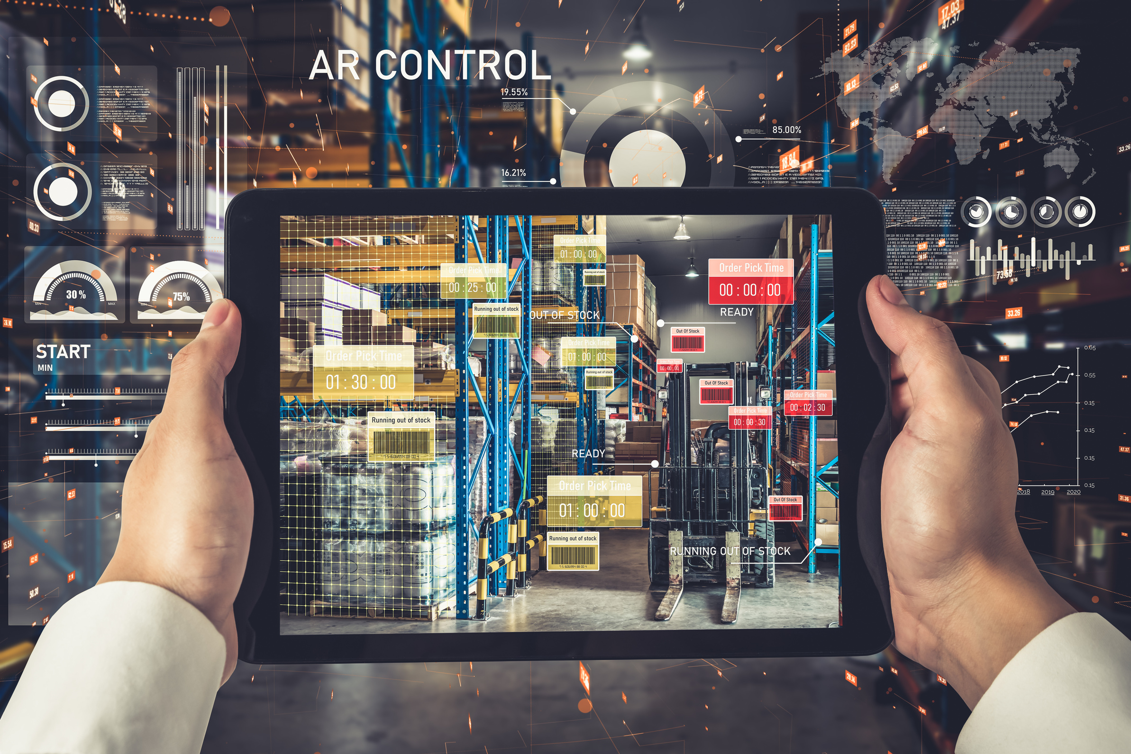

2022
ABSTRACT
This project aims to develop a smart security system using motion sensors and an ESP32 microcontroller. The system detects unauthorized movement with motion sensors and sends real-time notifications via email using the Blynk app

Slide 4
2022
INTRODUCTION
This project focuses on developing an efficient and scalable smart security system using motion sensors and an ESP32 microcontroller. The system is designed to detect unauthorized movement with passive infrared (PIR) sensors, which are sensitive to infrared radiation from warm objects such as humans and animals. Upon detecting motion, the PIR sensors send a signal to the ESP32 microcontroller. The ESP32, leveraging its integrated Wi-Fi capability, connects to the internet and uses the Blynk app to send real-time email notifications to the user’s smartphone. This ensures immediate alerts about any potential security breaches. Emphasizing simplicity and cost-effectiveness, the system provides a reliable solution for enhancing security in homes and small businesses, with potential for future upgrades like camera integration.

Slide 5
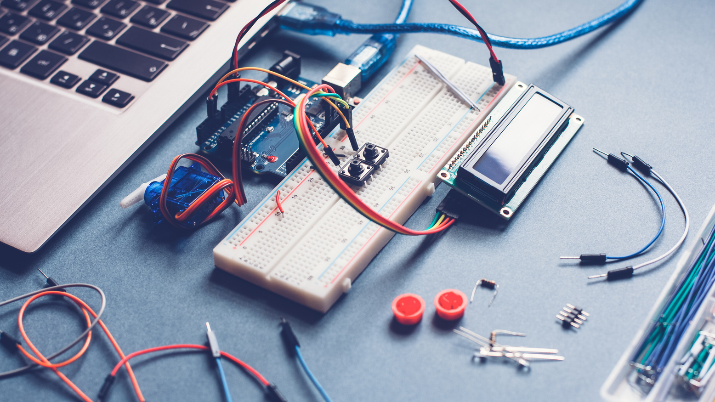
COMPONENTS USED
ESP32 Microcontroller
Motion Sensor
Breadboard
USB B type Data Cable
Jumper Wire

Slide 6
WORKING
This project focuses on developing an efficient and scalable smart security system using motion sensors and an ESP32 microcontroller. The system is designed to detect unauthorized movement with passive infrared (PIR) sensors, which are sensitive to infrared radiation from warm objects such as humans and animals. Upon detecting motion, the PIR sensors send a signal to the ESP32 microcontroller. The ESP32, leveraging its integrated Wi-Fi capability, connects to the internet and uses the Blynk app to send real-time email notifications to the user’s smartphone. This ensures immediate alerts about any potential security breaches. Emphasizing simplicity and cost-effectiveness, the system provides a reliable solution for enhancing security in homes and small businesses, with potential for future upgrades like camera integration.

Slide 7

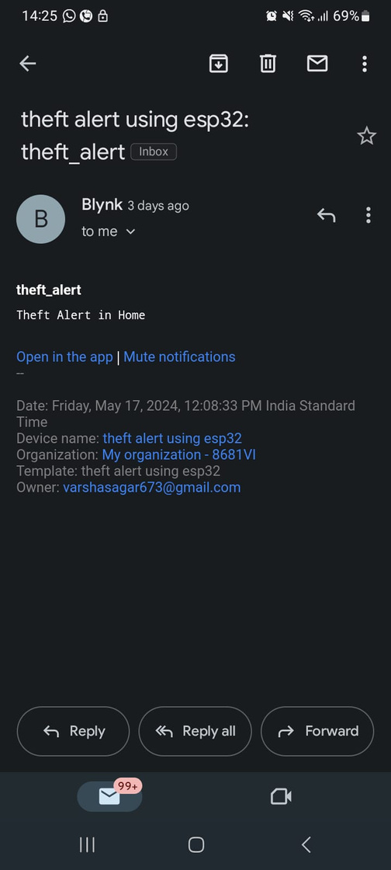
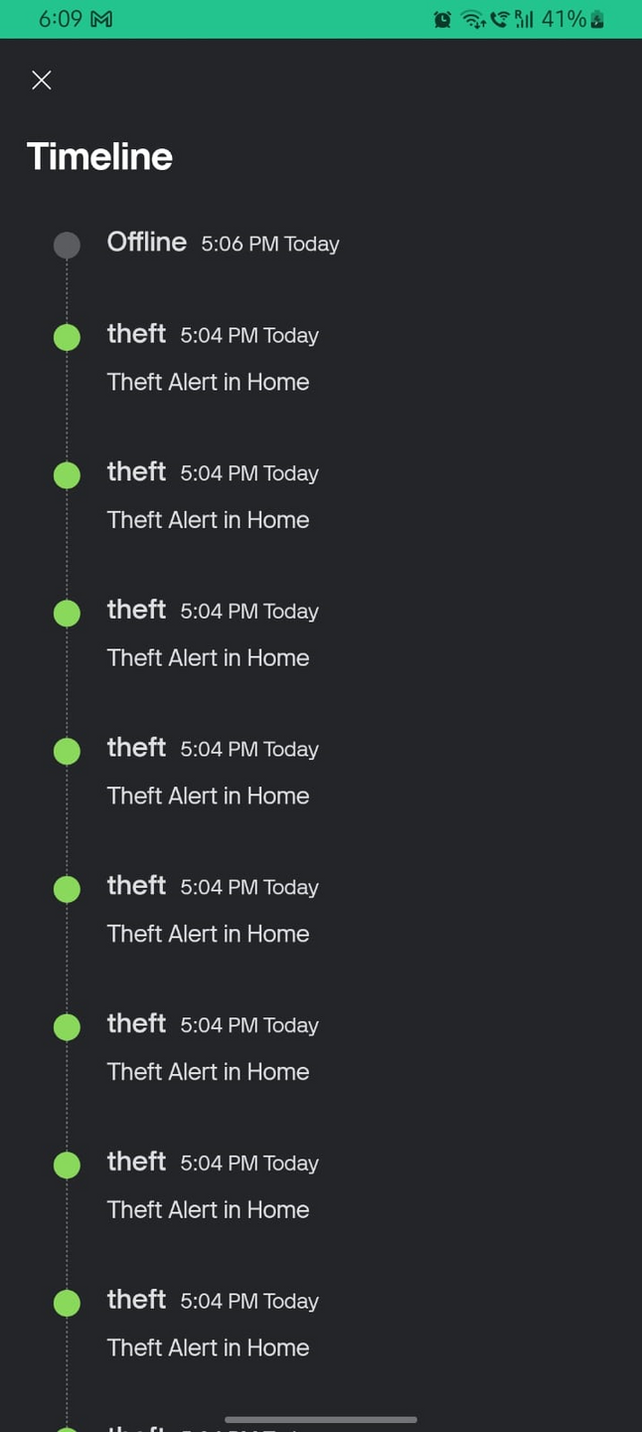
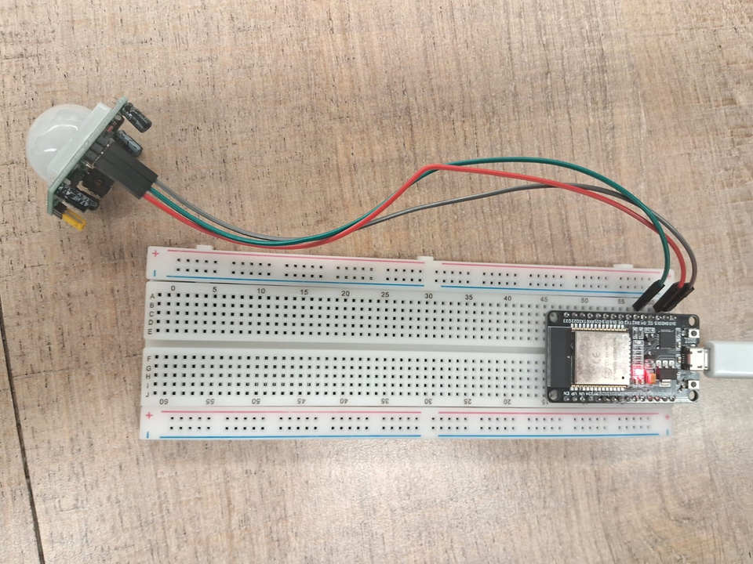
DIAGRAM AND OUTPUT

Slide 8

Application
1.Home Security:
Monitor entrances, hallways, and other critical areas to detect unauthorized access.
Receive instant alerts on your smartphone, allowing you to take immediate action or notify authorities.
2.Small Business Security:
Secure offices, retail stores, and storage areas by detecting intrusions outside business hours.
Provide real-time notifications to business owners, enabling rapid response to potential threats.

Slide 9
Application
3..Remote Monitoring:
Utilize the system in vacation homes or remote properties to ensure security when you are not present.
Integrate with smart home devices to automate responses, such as turning on lights or triggering alarms.
4.Elderly Care:
Monitor the movement of elderly individuals within their homes to ensure their safety.
Receive alerts if unusual movement patterns are detected, indicating a potential fall or emergency. etc

Slide 10
REFERENCE
https://www.youtube.com/watch?v=3082_a1HpDw https://www.sciencedirect.com/science/article/pii/S1877050919311378 https://www.espressif.com/en/products/socs/esp32

Slide 11







FOR YOUR ATTENTION

